Slide 1

Note: The data and information in this document is reflective of a hypothetical situation and client. This document is to be used for KPMG Virtual Internship purposes only.
Sprocket Central Pty Ltd
Data analytics approach
[Division Name] - [Engagement Manager], [Senior Consultant], [Junior Consultant]

Slide 2
Note: The data and information in this document is reflective of a hypothetical situation and client. This document is to be used for KPMG Virtual Internship purposes only.
Agenda
Introduction
Data Exploration
Model Development
Interpretation
Name – Naman Sood

Slide 3

Note: The data and information in this document is reflective of a hypothetical situation and client. This document is to be used for KPMG Virtual Internship purposes only.
Introduction
Data analysis to optimize resource allocation for targeted marketing
Areas covered throughout the analysis
Correlation among different attributes
Analysis of specific fields:
Gender
Wealth Segment
Job Industry
Age
State
Number of cars owned per state

Slide 4
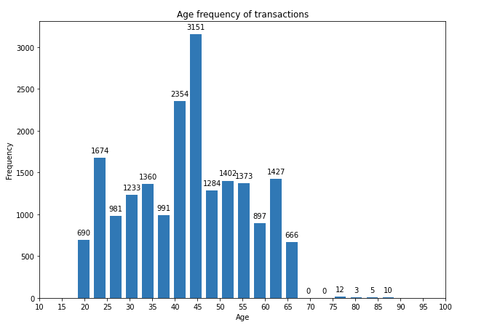
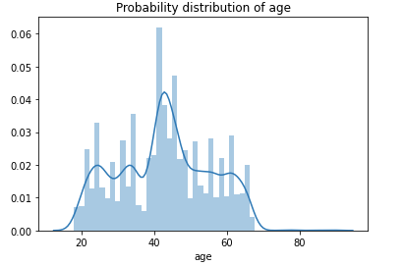
Note: The data and information in this document is reflective of a hypothetical situation and client. This document is to be used for KPMG Virtual Internship purposes only.
Data Exploration
Field analysis - Age
Through the histogram on the right, we can conclude the following points.
The company mainly caters to middle-aged people, the frequency shoots up from the ages of 40 to about 46. This is the target demographic.
There are a few outliers consisting of very aged people.

Slide 5
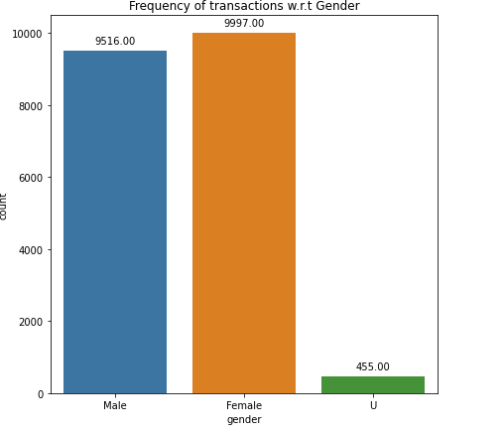
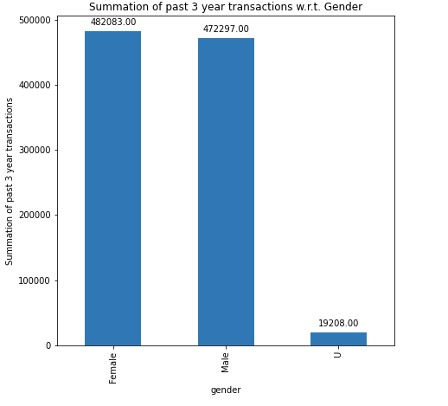
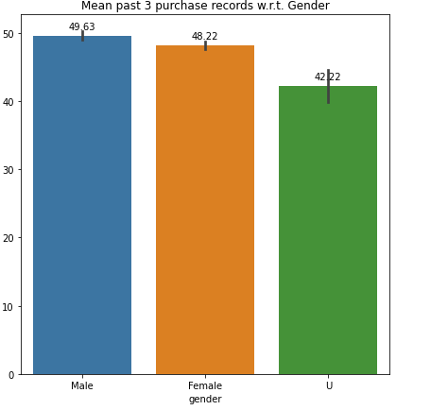
Note: The data and information in this document is reflective of a hypothetical situation and client. This document is to be used for KPMG Virtual Internship purposes only.
Data Exploration
Field analysis - Gender
Through the various plots on the right, we can come to the following conclusions.
There is a higher frequency of transactions performed by females vs other gender. Females perform 50.06% transactions
There is a higher mean past 3 year record purchase history of males but the total bought products is still less than females.
Females are our main gender demographic to focus on.

Slide 6
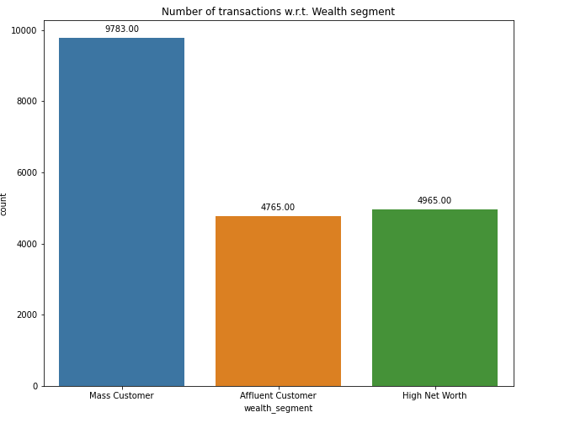
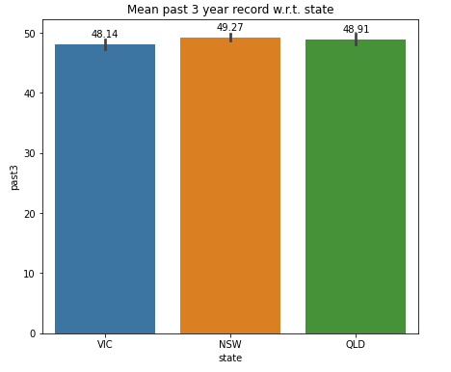
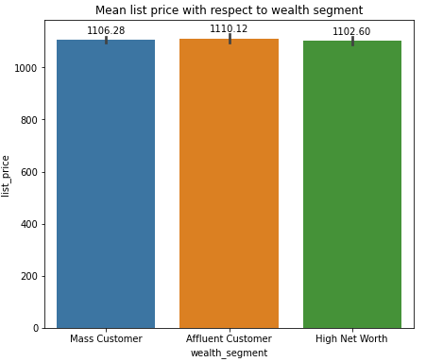
Note: The data and information in this document is reflective of a hypothetical situation and client. This document is to be used for KPMG Virtual Internship purposes only.
Data Exploration
Field analysis – Wealth segment
Through the various plots on the right, we can come to the following conclusions.
Mass customers have a huge margin of total transactions made (50.13)%
As there is not much difference between the mean order quantity and list price, we can conclude that Mass customers are the biggest participants.
Mass customers are the target wealth segment.

Slide 7
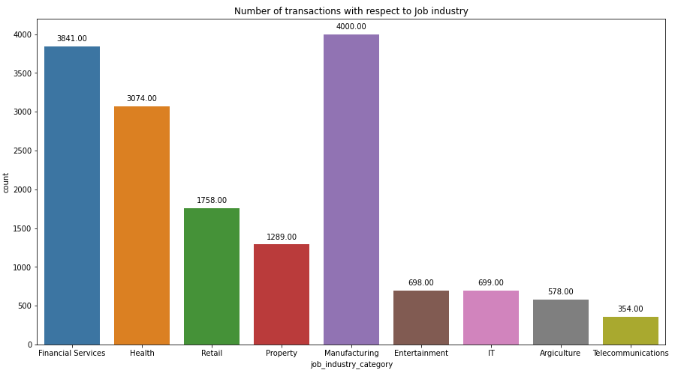
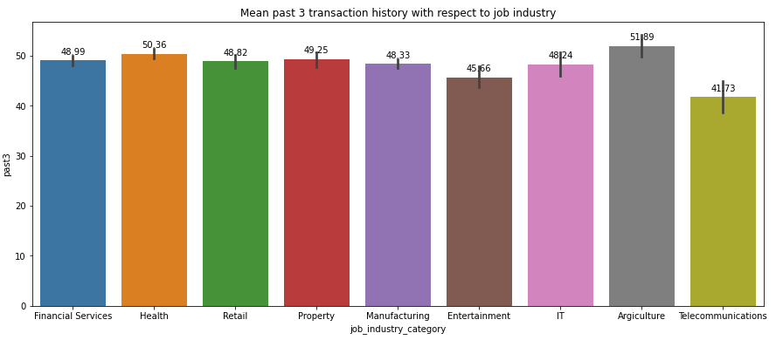
Note: The data and information in this document is reflective of a hypothetical situation and client. This document is to be used for KPMG Virtual Internship purposes only.
Data Exploration
Field analysis – Job industry
Through the various plots on the right, we can come to the following conclusions.
Manufacturing and financial services have had the highest frequency of transactions (accounting for 46% transactions)
The mean past 3 year transactions are nearly the same, therefore we can conclude that manufacturing and financial sectors are the main focus.

Slide 8
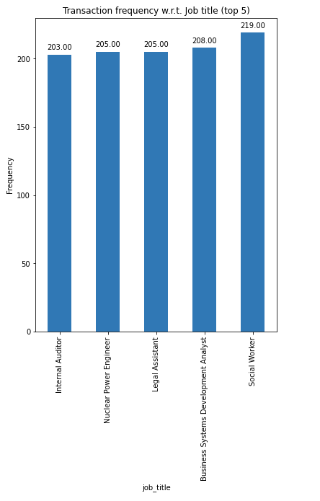
Note: The data and information in this document is reflective of a hypothetical situation and client. This document is to be used for KPMG Virtual Internship purposes only.
Data Exploration
Field analysis – Job industry contd.
Through the plot on the right, we can come to the following conclusions.
Through the recorded transactions, we can see that these 5 job_titles have had the highest transaction frequency in the given table (out of 195)
These should be the main focus of the companies

Slide 9
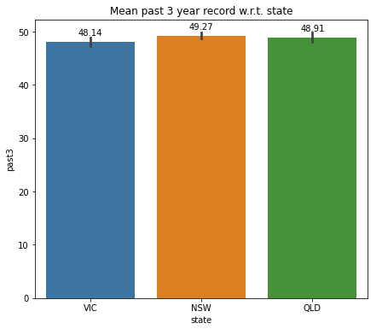
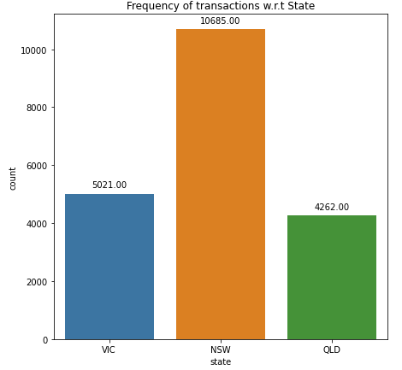
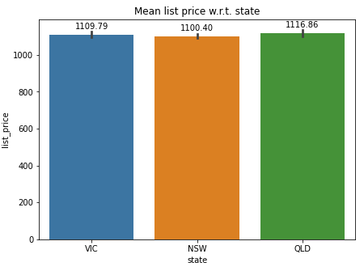
Note: The data and information in this document is reflective of a hypothetical situation and client. This document is to be used for KPMG Virtual Internship purposes only.
Data Exploration
Field analysis – State
Through the various plot on the right, we can come to the following conclusions.
The highest number of transactions have been in New South Wales (accounting for 53.5% transactions)
New Wales also has the highest mean list price of transaction and the mean past 3 year transaction record.
NSW should be the target demographic.

Slide 10
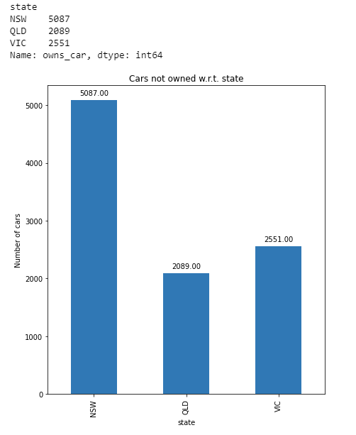
Note: The data and information in this document is reflective of a hypothetical situation and client. This document is to be used for KPMG Virtual Internship purposes only.
Data Exploration
Cars in Each state
Through the following plot on the right, we can draw the following conclusions:
As the company focuses on bikes, we have to look at areas with a deficit of cars.
New South Wales has had the highest frequency of transactions and owns the least amount of cars (recorded).
This reaffirms our target state being NSW for targeted marketing.

Slide 11
Note: The data and information in this document is reflective of a hypothetical situation and client. This document is to be used for KPMG Virtual Internship purposes only.
Data modelling
Data pre-processing, cleaning and feature generation
The following tasks were performed to clean the dataset for a more streamlined and focused data analysis pipeline:
Removing columns unneeded for the analysis – unnamed columns, transaction date, default etc.
Engineering a new feature – Age, through date of birth
Cleaning the gender column to group up the Male, Female and U categories.
Cleaning up the state column to group up the NSW, Victoria and QLD regions.
Creating a correlation heat-map matrix to include numerical features as well as categorical features in the respective dataset.
Merging the Transactions, Customer Demographic and Customer Address datasets to get a super set of all data and features (joined through the customer_id column).

Slide 12
Note: The data and information in this document is reflective of a hypothetical situation and client. This document is to be used for KPMG Virtual Internship purposes only.
Interpretation
Final key points and conclusion
Throughout the data analysis pipeline, we have researched many different fields and come across different relations between the data. Some of our key findings are as follows.
The key gender that should be targeted are females
The region of New South Wales should be targeted as the hotspot for future sales.
The wealth segment of mass customers should be the main focus and the jobs that are the priority purchasers are social workers, business systems development analyst, legal assistant, nuclear power engineers and internal auditors.
The middle age demographic should be the main focus, specifically ranging from the age of around 40 to about 45-47 years old.

